Slide 1
GUITAR BEGINNER COURSE : week 1

Slide 2
INTRODUCTION

Slide 3
today’s acitivity
ROLES OF GUITAR PLAYERS
GUITAR PARTS
TUNING
LETTER NOTATION
FRETBOARD NOTES
BASIC STRUMMING: 4 COUNTS AND 2 COUNTS
YOUR FIRST CHORDS: C A G E D
YOUR FIRST SONG: LORD I LIFT YOUR NAME ON HIGH

Slide 4
Types and role of guitar players

Slide 5
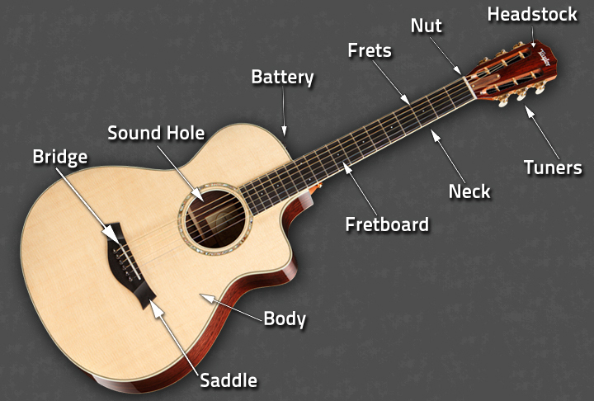
Guitar parts: acoustic

Slide 6
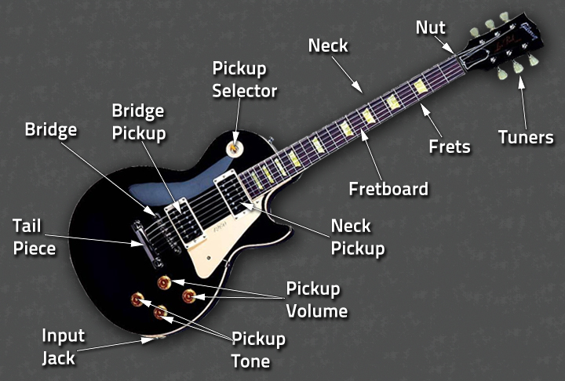
Guitar parts: electric

Slide 7
tuning

Slide 8
Letter notation
System of representing a set of pitches by letters
There are 12 semitones in a western music (the most common
A – B – C – D – E – F – G
Advantage : Easy to remember / memorize

Slide 9
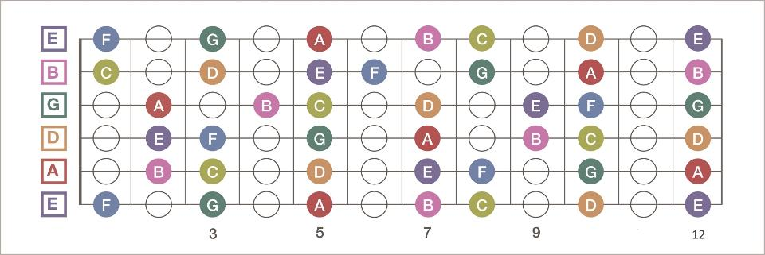
FRETBOARD NOTES

